Slide 1
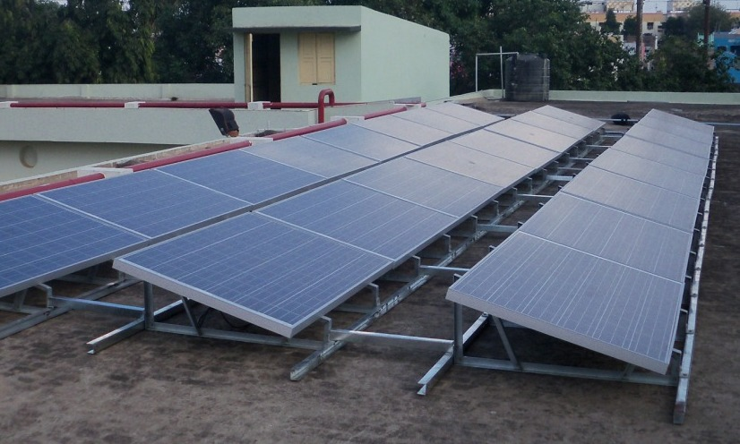
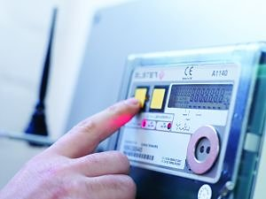
Grid Connected Solar Rooftop
A Discom perspective
हर दिन रोशन, हर पल रोशन... बीएसईएस से दिल्ली रोशन !
Munish Sharma
AVP & Head Business Strategy
BSES Rajdhani Power Limited
BSES Yamuna Power Limited
A joint venture of Reliance Infrastructure Ltd. & Delhi Govt.
Notes:
1

Slide 2
Presentation Flow
Indian Power Sector & Solar Ecosystem in Delhi
Re-visiting RE Targets (2022) & Enablers
BSES foray into Solar
Discom Perspective
Summing Up

Slide 3
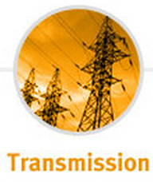
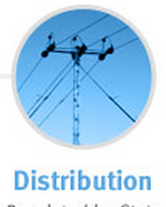
India’s Electricity Sector Evolution
HYDRO
COAL
NUCLEAR
GAS
RENEWABLES
Yr 2016
G
Generation Mix : Central : 25% ; State : 34% ; Private : 41%
Installed Capacity : 305 GW
Generation Type : Non-Renewable : 86% ; Renewable : 14%
World Ranking : 4th (5% of World Share)
220 kV
400 kV
765 kV
+ 500 kV
HVDC
+ 800 kV
HVDC
1200kV
UHV AC
T
Transmission Mix : Central : 38% ; State : 56% ; Private : 6%
Loss : ~1.5% of GDP
LT
HT - HVDS
# SMART GRID #
# Solar Rooftop#
Ownership (Energy MU) : State : 90% / Private 10%
AT&C Loss Levels : All India @ 22.7% ; BRPL @12.7%
Load Mix : Industry (402.7%); Farms (30%); Houses (30%)
DELHI : 4% of India’s Consumption
D

Slide 4
FACTSHEET : Indian Power Sector
ACCESSABILITY
~300 million (22% of population w/o electricity)
ALTERNATIVE
80 BUs generated by DG sets annually (~15 MTs of diesel oil)
AVAILABILITY
11 % Peak Shortage
PREDOMINANCE
SEBs run at High operational Losses, Lack innovation & Customer centricity
AFFORDABILITY
All most all SEBs surviving on Govt aid/ Subsidy
Source : World Wide Web
For Economic stability, these issues need to be addressed at all levels

Slide 5
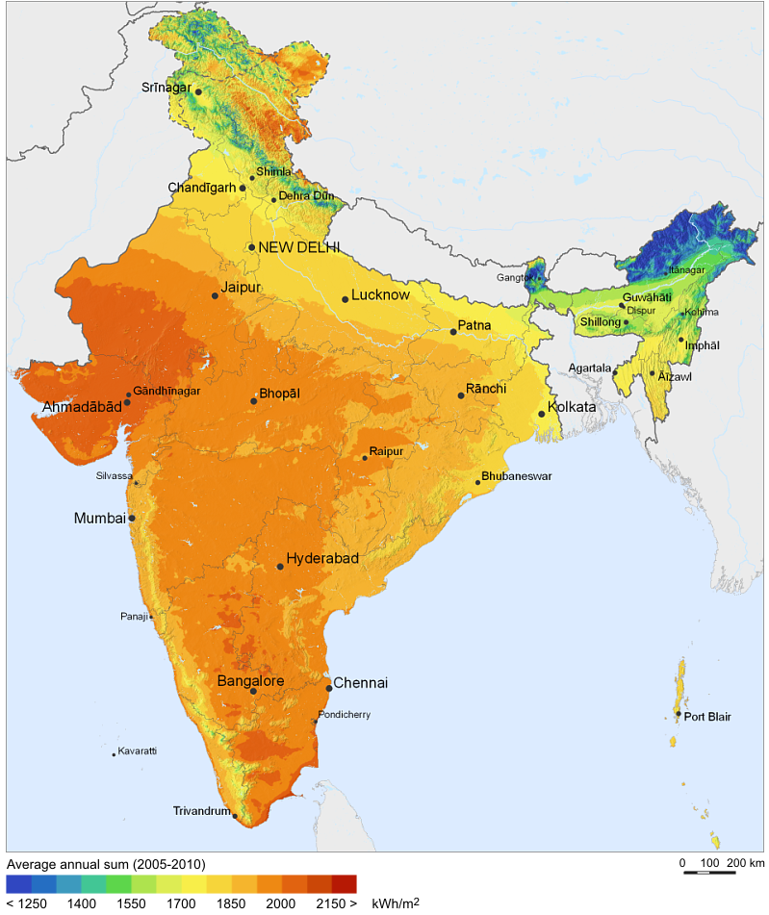
India’s Solar Map & Installed capacity
Installed solar PV on 31 March 2016
Year | Cumulative Capacity (MW)
2010 | 161
2011 | 461
2012 | 1,205
2013 | 2,319
2014 | 2,632
2015 | 3,744
2016 | 6,763
CAGR : 87%

Slide 6
Current Renewable Scenario in India..
RE Target: 1,75,000 MW (2022)
Sunshine Sector
Innovative designs (Solar & Wind projects) for minimum land utilisation.
Smart Cities to be powered by Green Energy
On the Radar
Roof-top Panels
Canal-top Panels
Hybrid farms (Solar + Wind)
RE Plants near pithead plants to reduce transmission cost
Sunshine Sector
On The RADAR
Firm commitments: 2,66,000 MW
Expected investment: $300 bn
Rs 6-8 Crores for setting up
1 MW Solar Generation capacity

Slide 7
SWOT Analysis – Solar in India
STRENGTH | WEAKNESS
Ample sun: ~300 sunny days/ yr Ease of installment Savings (consumer Net metering) Environment friendly | High initial installation cost & regular maintenance. Higher Cost of production (Rs 15 - Rs 20 p.u) against conventional (Rs 2 - Rs 5 p.u). Lesser Reliability (Fog cloudy days). Lack of Knowledge/ technical support.
OPPORTUNITY | THREAT
Aggressive targets by Govt. Govt. support (Subsidy) Best alternative fuel (Electric vehicles). Environmental concern w.r.t Nuclear/ Coal More players >> Competition >> Customer benefit. | Inferior quality Indian solar cells (against Australia/ Germany) thus further pushing Uranium import. Only large investors can survive China has competitive edge with lower cost.

Slide 8
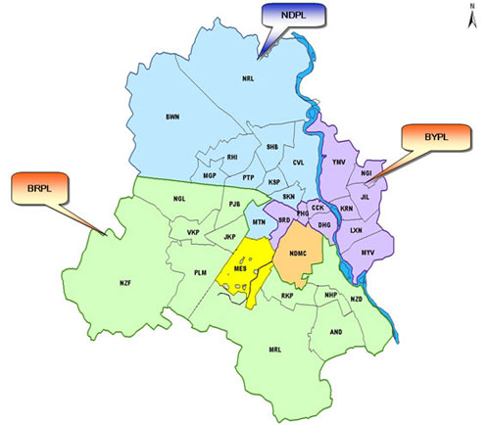
Solar for Delhi...few statistics
Power Demand: Touched 6260 MW.
65% more than Mumbai
3 times of Kolkata
4 Times of Chennai
Doubled in past decade
Increasing by over 6% each year
Total power requirement to touch 33 BUs in 2017.
Limited Generation Delhi dependent on other states for over 80% of its requirement
Solar potential: >2500 MW (using just 1.6% of total land area)
Solar panel costs down by over 80% since 2008. (Source: New Climate Economy Report)
TPDDL
BYPL
BRPL
Falling solar equipments prices coupled with push by Govt.
is making solar a lucrative option

Slide 9
Presentation Flow
Indian Power Sector & Solar Ecosystem in Delhi
Re-visiting RE Targets (2022) & Enablers
BSES foray into Solar
Discom Perspective
Summing Up

Slide 10
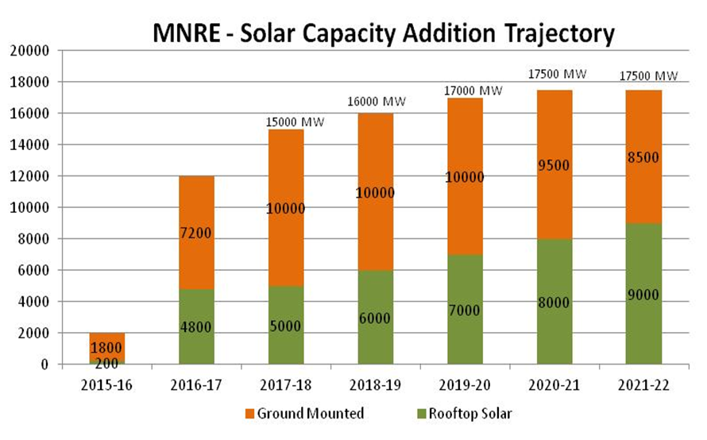
Re-visiting Renewable Targets (2022)
Renewable Energy Capacity Target (175 GW)
100 GW Solar [60 GW: 40 GW; Grid scale Vs rooftop Solar PV]
60 GW Wind
10 GW Bio mass
5 GW small Hydro
National Tariff Policy 2016: Target of 8% Solar RPO (excl Hydro from total generation), translating to about 7.2% of total generation from Solar
Source: MNRE

Slide 11
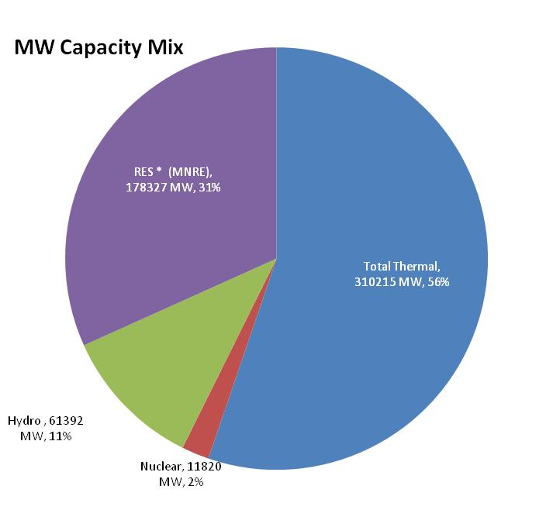
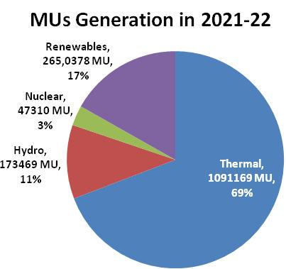
2022 Capacity extrapolation & Impact..
Assuming achievement of 175 GW RE addition:
Installed Capacity would be 562 GW (85% growth)
Thermal Capacity would be 56% of Overall (46% growth)
Renewable share from 14% to 31% (300% growth)
Total Estimated Generation of 1,577 BUs (5.1% growth p.a)
Renewable expected to contribute ~17% of Generation
Thermal 69% of Generation with PLF reduced to ~40%
Reduced Hydro ~11% of Generation
Considering Renewable as “Must Run”, PLF of conventional plants would fall leading to increase in Avg. Unit Cost
Source for Capacity Projection other than RE: CEA

Slide 12
Enablers for Solar Rooftop Target of 40 GW
SUSTAINING GROWTH
1) Reducing skill gap
(Industry, Regulator & Utility)
2) Maximizing Rooftop space
3) Mandate to drive adoption after ecosystem in place
CRITICAL BUILDING BLOCKS
1) Providing level playing field for investors
2) Rapid Consumer Awareness
ESSENTIAL FOUNDATION
1) Ease of Net Metering
2) Fair deal for Discoms

Slide 13
Humongous Resource Mobilization
Man
Incremental requirement of 1.1 mn skilled manpower
Project, Engineering, Construction/ Commissioning
Monitoring, Operation & Maintenance
Machine
Domestic Capacity ~1212 MW cells & 5620 MW Modules p.a.
Modules majorly imported from China (having 70% import share)
Rest equipment (Inverters) have similar outlook
Money
Total Investment Required ~ Rs. 6,00,000 Crs ($ 90 Bn) over 6 Yrs.
Solar Equipment to be ~4% of India’s Annual Import Bill
Banks & FIs committed funding for 77 GW Capacity.
PSUs committed ~20 GW Solar Capacity, whereas, Pvt. Sector committed ~ 263 GW
Initial ramp-up of trained manpower
Import obligations
Sustainable financing mechanism

Slide 14
Presentation Flow
Indian Power Sector & Solar Ecosystem in Delhi
Re-visiting RE Targets (2022) & Enablers
BSES foray into Solar
Discom Perspective
Summing Up

Slide 15
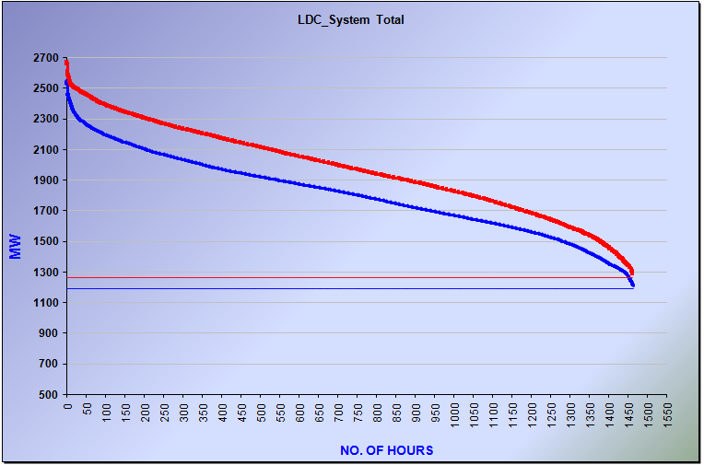
BRPL Load Duration Curve – Summers 2015 & 2016
Peak Load | May & Jun-15 | May & Jun-16 | Multiples
>2500 MW | 1 Hr | 20 Hrs | 20 X
>2400 MW | 10 Hrs | 90 Hrs | 9 X
>2200 MW | 92 Hrs | 354 Hrs | 4 X
Peaks are occasional, However BRPL faces it persistently
Only 46 hours in a year load remains above 2300 MW.
Only 115 hours in a year load remains above 2200 MW.
Notes:
June 15: 1,282 MUs
June 16: 1,456 MUs
% Increase : 14% Increase

Slide 16
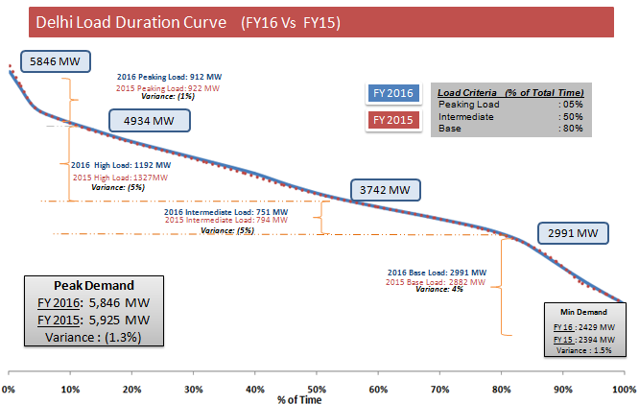
Understanding Electricity Demand (LD Curve)
Peak demand is normally for few Hrs
Behavior
Varies a lot in a day
Varies with seasons
Have peaks and Non peaks
Each Discom is exclusive
Peak Demand
Affects Supply quality
Can results to shortage & finally outage
Very high technical losses
Key factor for planning
Non Peak (Surplus)
Affects Supply quality
Poor efficiency of infrastructure
Idling of infrastructure
Plan Energy Conservation as per Demand curve need.
Cost Conservation Impacting Power Infrastructure especially @ PEAK.
Load Shifting
- Peak to Non peak
Ideally Demand Curve should be flat, for Best Efficiency , Lower network loss,
Good power quality, Reduced outages, Efficient usage of investment

Slide 17
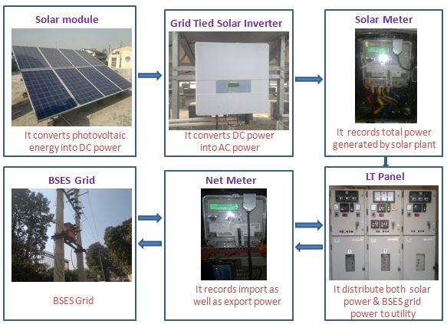
Net Metering - Stages
1st stage - Application
Consumer: Receipt of Application Form
Discom: Technical feasibility
Discom : Application Approval/ Rejection on the basis of technical feasibility
2nd stage – Registration
Consumer: Receipt of Registration form
Discom : Technical evaluation
Discom : Site visit of solar plant
Discom : Registration form Approval/ Rejection
Discom and Consumer : Net metering connection agreement
3rd stage - Net meter installation
Consumer: Solar plant installation & Intimation
Discom : Auto debit necessary charges through electricity bill
Discom : Net meter installation

Slide 18
Roof Top Solar @ BSES
Pioneer (first connection April 2015) & is Leading player of roof top systems in Delhi with highest Net Metering connections amongst all Delhi discoms.
Worked actively with Govt. of India/ metering companies in devising standards/ meters for Net Metering
Description | Customer Category
 | Domestic | Non Domestic | Industrial
Solar plant capacity | 5 Kwp | 5 Kwp | 5 Kwp
Retail tariff | 9.64 (8.53 IN R+ 8% surcharge+ 5% tax) | 11.92 (10.55 IN R+ 8% surcharge+ 5% tax) | 11.38 (10.07 IN R+ 8% surcharge+ 5% tax)
Retail tariff escalation (assumed) | 2 % p.a. | 2 % p.a. | 2 % p.a.
Solar plant supply & installation cost | Rs. 3.75 Lacs | Rs. 3.75 Lacs | Rs. 3.75 Lacs
Unit Generation per annum (approx.) | 5,866 Units | 5,866 Units | 5,866 Units
PAYBACK Period | 10 Years | 5 Years | 5 Years
Tax benefit with accelerated Depreciation | 0 | Rs 1.12 lacs | Rs 1.12 lacs
Savings in Electricity Bills for 25 Years | Rs 11 lacs | Rs 19 lacs | Rs 18 lacs
Disclaimer: The above workings are purely for illustrative purpose and BSES in no way confirms the accuracy of the same. Savings (if any) shall be determined as per variety of factors, including but not limited to CUF of the plant, climatic conditions, consumer consumption, installation efficiency, rules regulations and tariff as notified from time to time.
Illustrative example

Slide 19
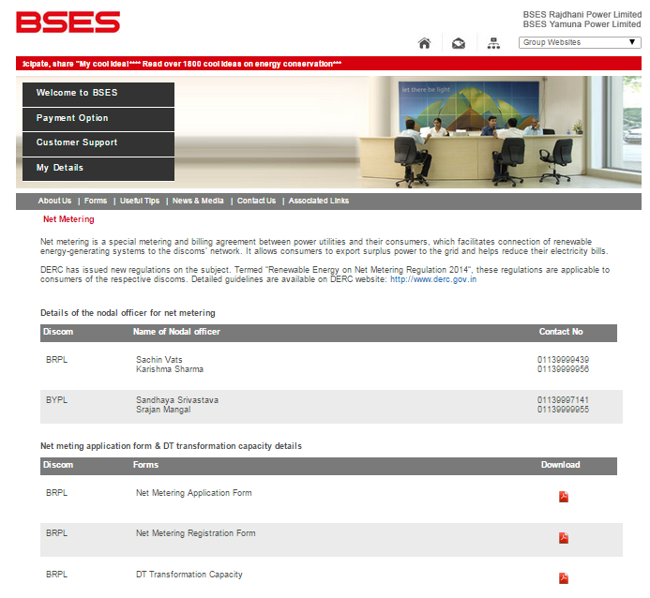
BSES website offering all details..
http://www.bsesdelhi.com/HTML/NetMetering.html

Slide 20
BSES scoreboard in Solar Roof Top
Connections Energized
202 No.
Total Sanctioned load
8820 KW (8.8 MW)
Pipeline
>90 projects
(BRPL 161, BYPL 41)
Consumer types
Educational institutes (26 no./ 1 MW)
Commercial/ Govt. establishments
Domestic households
Consumption range
1.8 KW to 1000 KW
Savings achieved
Rs 1800/- per mth to Rs 10 lac/ mth

Slide 21
Presentation Flow
Indian Power Sector & Solar Ecosystem in Delhi
Re-visiting RE Targets (2022) & Enablers
BSES foray into Solar
Discom Perspective
Summing Up

Slide 22
Divergent Considerations
National Policy
Energy Security
Climate Change
Electricity Shortages
Electricity Access
Power Distribution Arena
Ensure Electricity Access in a cost-effective way
Provide Reliable Power Supply without Shortages
Optimize Power Cost through Demand Forecasting and Power Scheduling
Such diverse considerations require high degree of confluence
to achieve National Targets

Slide 23
Discoms active role in making a sustainable ecosystem
Discom
Govt.
Developers
Consumers
Regulator
To focus beyond targets
Regulators to be actively (rather proactively) involved in this evolution
Consumers and Developers to consider risks also apart from benefits.

Slide 24
Impact of Solar on Discom Operations
Attribute | Impact | Proposed Actions
Transmission Network | Conventional plants need quick adaptation (Ramp up & down) | Up-gradation of conventional plants. Plants located near Load Centers to be PPA free & used for Grid Support by RLDCs.
Distribution Network | Reversals & dynamic power flows | Advanced load flow studies Dynamic protection arrangements Investments in Smart Grid Capability building
Demand Forecasting | Due to variability, forecasting would be a dynamic challenge | Discom to develop Distribution System Operator capabilities. Needs to integrate and monitor data from each PV plant and invest in Storage
Tariff | Solar can only reduce Day Peak, Discom still needs to tie up for Night Peaks. | Solar Tariff would be offsetting only the Variable Tariff and hence would lead to consumer tariff increases. Support/ subsidy may be required.
Discom retail sale | Net Metering reduces the net sales of Discom eroding good units base. | Consumers cannot be self-sufficient with Solar alone. Hence total consumption to be accounted as Discom sales.

Slide 25
Discom expectations from other Stakeholders
Centre & State Govt. (Facilitator)
Able Policy Support
Funding Mechanism
Capacity & Capability Building (Global expertise)
Regulators (Balancer)
To play pro-active role & provide regular guidance to all.
Realistic RPO targets aligned to state profile.
Ensure balance between Govt. Targets & Discom ability.
Developers & Consumers (Lubricator)
Collective concern not individual..we need to be future ready..
Solar Equipment performance affects Grid (Safety/ Grid response)
Consumers to act responsibly & understand the evolutionary process.

Slide 26
Presentation Flow
Indian Power Sector & Solar Ecosystem in Delhi
Re-visiting RE Targets (2022) & Enablers
BSES foray into Solar
Discom Perspective
Summing Up

Slide 27
Benefits of Roof Top Solar
Grid Safety
Help Moderate Afternoon Peak Load
200 MW Savings
1MW (~ 10Cr Saving)
G(5Crs)
T(2.5Crs)
D(2.5Crs)
RPO fulfilment
Rooftop generation helps to meet RPO
Happy Customer
Lower Bill to Consumer
Few countries (Germany) have witnessed new problem...
Sudden demand growth during sunset.

Slide 28
Few Open issues…….
Roof Top Solar installation on Unit Rate basis
Can Discom / Financer disconnect on Non payment ?
Agency for certifying installations & periodic calibration
Banning non-complying Meters/ Inverters.
Legal risks
Misuse of Rooftop approval letter for ownership
Compensation for Surplus export energy ??
Real-time Energy Audit & T&D loss reporting
Lack of viable Financial incentives

Slide 29
Way forward..
Prime consideration: Discom side of the Story needs to be carefully analyzed and aligned with overall objective to ensure Sector Sustainability..

Slide 30
Thank You
Get Connected Through Roof Top Solar & Cut Your Electricity Bills
E-m@il : brpl.bd@relianceada.com / byplbd@relianceada.com
For any queries regarding this presentation may please contact :
Tel: 011-3999 9810
Email: munish.sharma@relianceada.com

